Slide 1
Your careers interview
How to prepare for your careers guidance interview

Slide 2
What is a Careers Guidance Interview?
Watch this short video and we’ll explain
Career Guidance Interview

Slide 3
How to Prepare
In the coming weeks you’ll be offered a Careers Guidance interview. This presentation will help you to understand what to expect and how to prepare.

Slide 4
Your Ideas
Think about your career ideas:
Do you have any ideas already that you would like to discuss?
You may have lots of ideas or you may have none! That’s absolutely fine.
Do some research using the tasks in the workbook.
Think about each job and make a list of pro’s and cons
We don’t expect you to know everything but a bit of research really helps!

Slide 5
Your current Situation
Think about your current situation
What are your predicted grades? This can help you to make realistic decisions
Think about your school report. Is it positive, negative, a bit of both?
Think about what makes you proud? Do you help your community? Do you play for a sports team? Do you help out at school?
Think about the skills and qualities you have? Are you helpful? Hardworking? Reliable?
It can be hard to identify these yourself so talk to your family, friends or teachers to help.

Slide 6
Any Barriers to Success
Finally consider what your barriers to success might be
In other words what might stand in your way of success in your career and in your life
You need to be honest with yourself and with us
If you identify any issues now, like being late to school, having issues with your behaviour, being anxious about school your Career Adviser can help you to plan to make improvements
This might include referring you to other agencies that can help to support you

Slide 7
In the Interview
Your Career Adviser will ask what you would like to discuss but don’t worry if you’re not sure. The Career Adviser can lead the way and will ask lots of questions to get you thinking
They will talk through your ideas, make suggestions and give you information. Don’t forget to ask if there’s anything you don’t understand or you have any questions

Slide 8
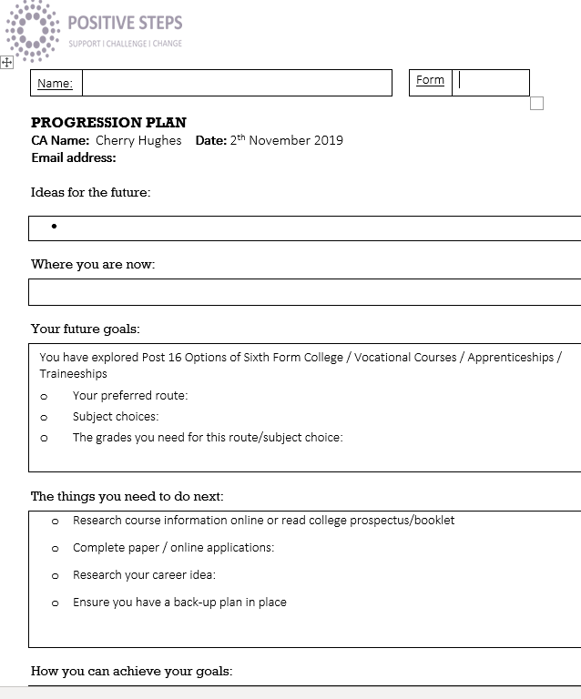
After the Interview
Your Career adviser will take brief notes and complete a Progression Plan (also known as an Action Plan) which they will then email over to you. It will contain a summary of your meeting and you will set action points together to help you carry on your planning after the meeting.
Don’t forget to make sure we have all your up to date contact information so we can send this to you and follow up any actions we need to take after the meeting.

Slide 9
So what next?
Your Career adviser will be in touch to explain how your interview will be arranged.
Next, work your way through the tasks in the workbook and use the websites you have been give to help prepare.

Slide 10
Your Career Adviser is: Pete Tupman E: petertupman@positive-steps.org.uk T: 07471036677 Rochdale Careers Team Contact: rochdalecareers@positive-steps.org.uk General telephone number: 0161 621 9290
Positive Steps is a registered charity that provides career guidance services in Oldham, Rochdale and Tameside.
We also provide an Employment & Skills Service and a range of other support services for young people, adults and families.

